Slide 1


Slide 2
Project Report Table of Contents
Executive Summary
Research Objective
Research Plan and Methodology
Data Findings
What makes a successful gamer?
What are the psychographic/demographic makeup of eSports viewers? What is the public’s perception of eSports in general?
Where should advertisers spend marketing dollars?
Conclusion
Recommendations

Slide 3
Executive Summary
The Problem: There is an emerging market in eSports gaming that not only sees Year over Year (YoY) growth (13.8% in 2018), but untapped revenue in the $Billions.
The Objective: Analyze 3 target questions to illuminate who and where to advertise
1) Who are the gamers (athletes)?
2) Who are the spectators?
3) Where should advertisers spend?
The Target Audience: Advertisers that may align with eSports branding, looking to capitalize on a market with high/growing viewership
The Vision: With participants identified, and the market laid out, it is our vision that Advertisers and Brand Ambassadors will be able to start making decisions on whether eSports is the right venue for their promotions, as well as what segments to be aware of or avoid.

Slide 4
Research Objective
A challenge in the eSports industry is its newness and its underexpansion. The barriers of entry are low in and for the most part the industry is making rules up on the fly. Since it is so new, there aren’t proven ways to advertise and monetize things like in other sports. Our research is focused on helping businesses better understand the ever-evolving trends and opportunities by providing information through our objectives:
Segmenting eSports top performers in order to give advertisers an idea of the demographic of top eSports performers which will allow them to target relevant viewerships, ages, games, genres, tournaments, and countries
Better marketing strategies for advertisers in the video game industry. Advertisers will know individual preferences and attitude towards eSports and will be able to develop their marketing in a more accessible way
Analyzing the market share and trends of the eSports industry in order to provide a framework and demonstration of the vast growth and opportunity available in the eSports market. These insights will be valuable in the future as the industry continues to expand

Slide 5
Research Plan and Methodology
Question 1:
What makes a successful gamer?
This analysis will allow us to explore popularity of gamers in the industry, and potential trends in competition.
Data Sources: Top 500 Highest Earners, Highest earners by age, Under 18 earners, Highest earners by country and Top players 2019
Analysis Method: Cluster analysis, K-means clustering of segments of top performers in eSports by age, country, prize money, genre, game
Question 2:
What are the psychographic/demographic makeup of eSports viewers? What is the public’s perception of eSports in general?
We will also look at eSports survey data to help identify the typical eSports viewer. This will help discover a target or emerging audience for advertisers.
Data Sources: Morning Consult Poll Data
Analysis Method: Segmentation
Question 3:
Where should advertisers spend marketing dollars?
Explore these general eSports industry trends and market share for advertisers.
Data Sources: Top 100 tournaments, Largest team tournaments, Top 100 countries for 2019, Highest earners by country, Games with the most prize money, Highest earnings by age, Global eSports market revenue share 2019, and Worldwide eSports viewer numbers 2012-2022.
Analysis Method: Regression, Descriptive Statistics

Slide 6
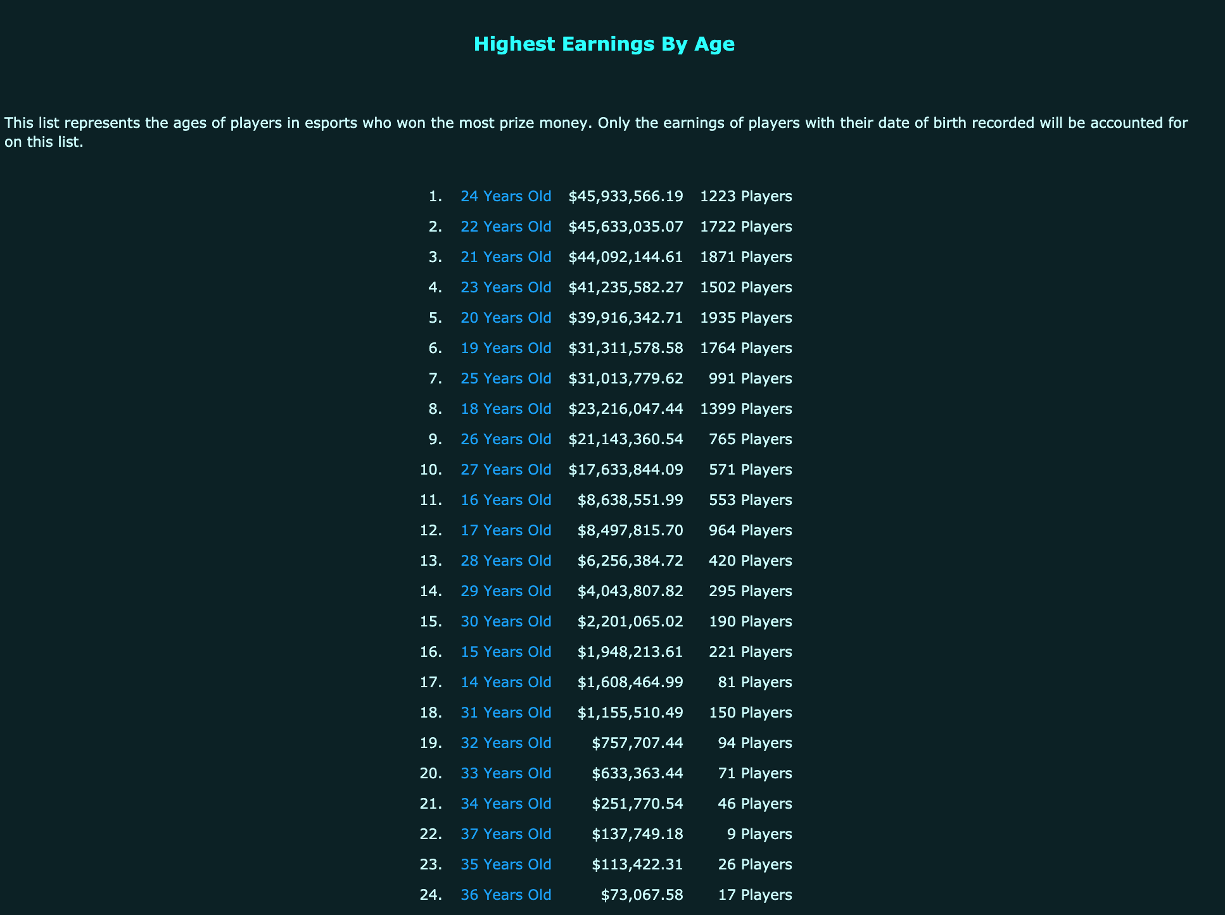
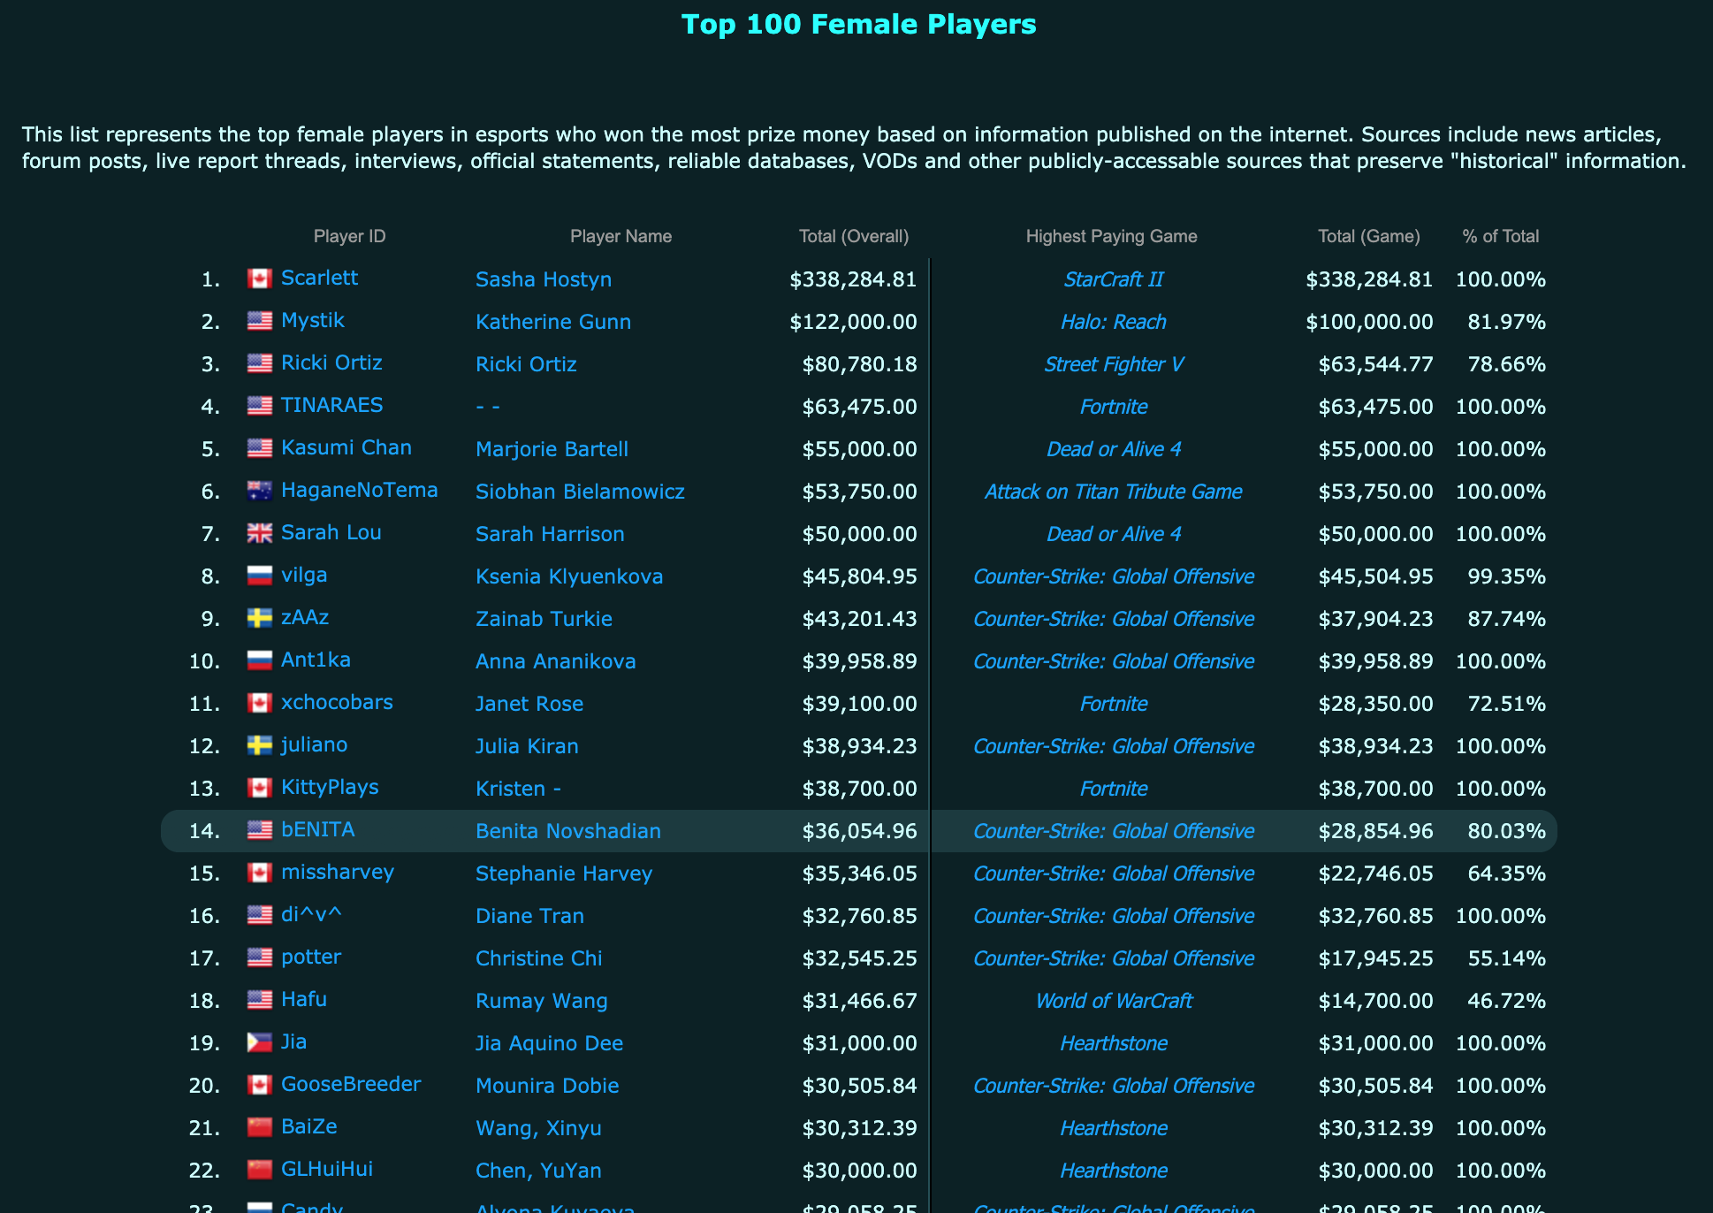
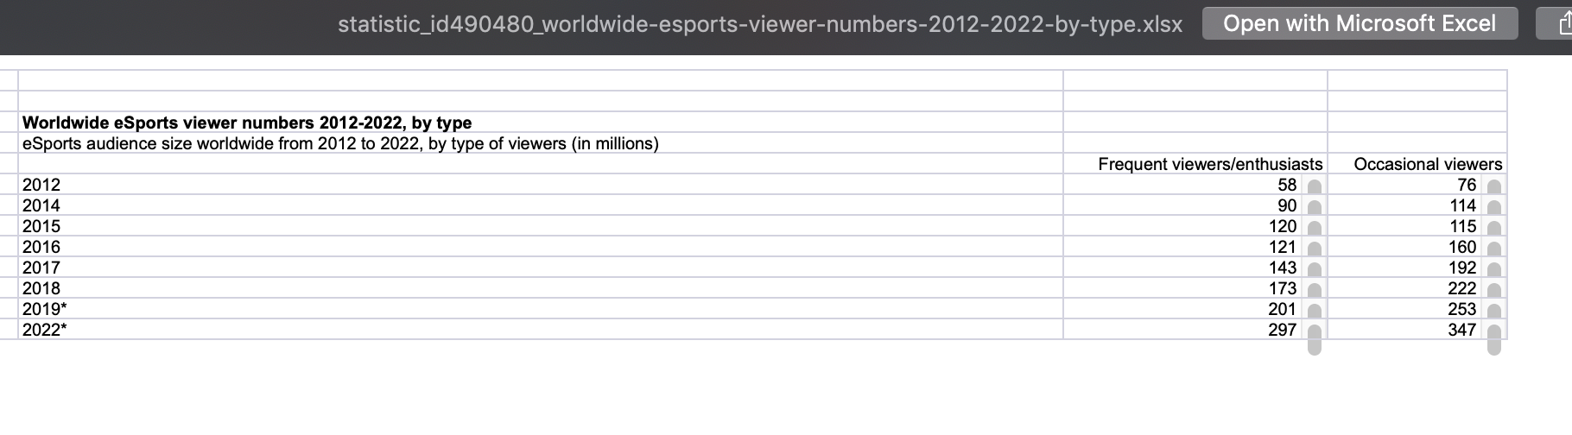
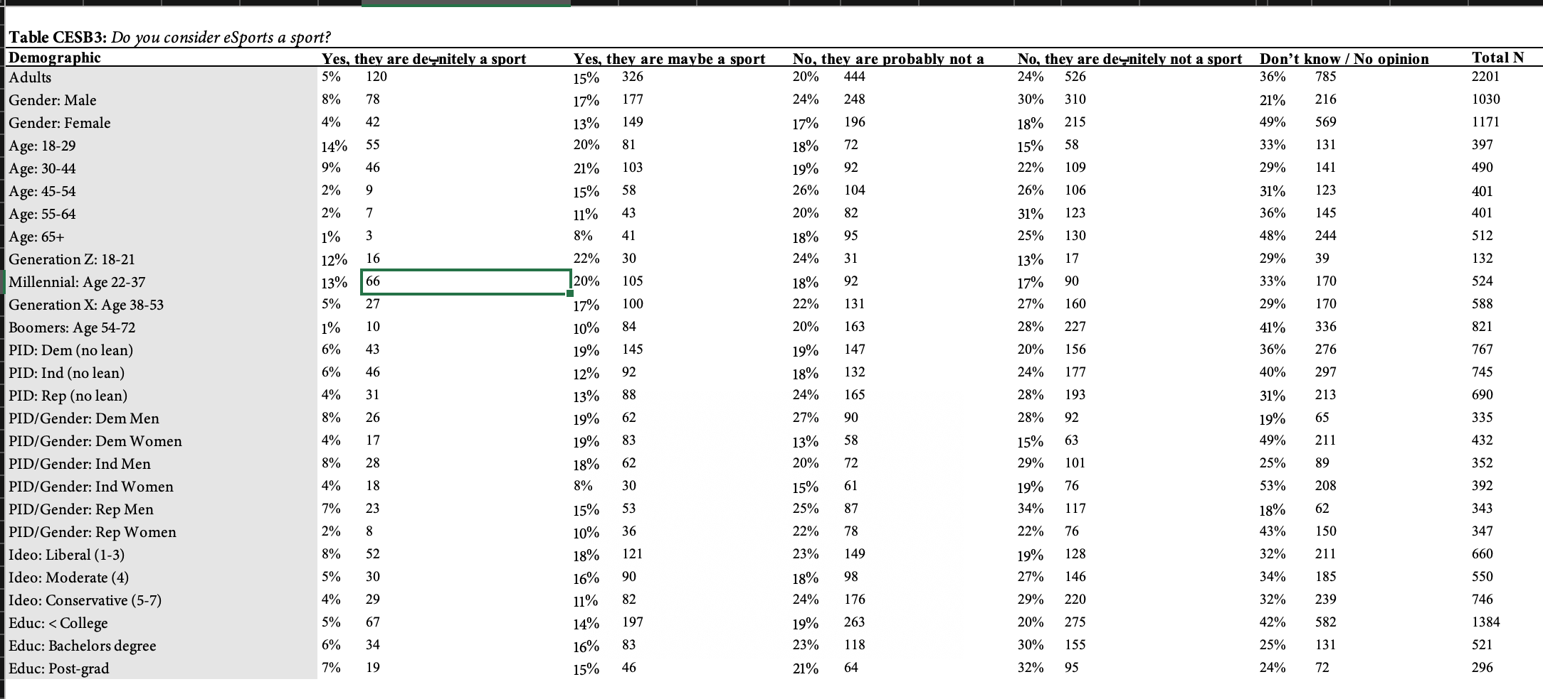
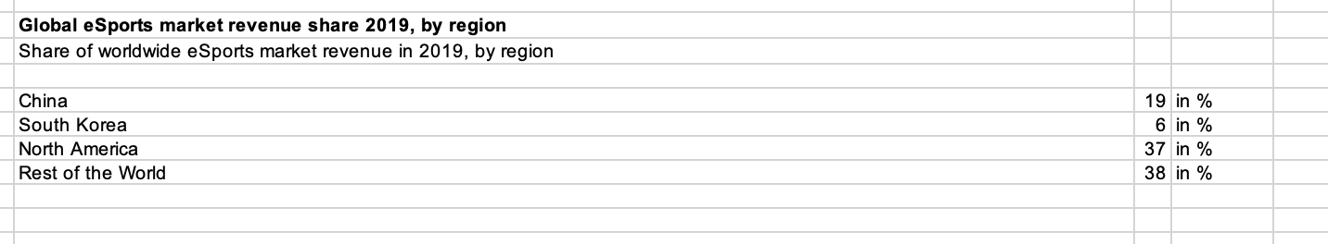
Sources of Data
Top data from Esportsearnings.com with Player, Prize and Game data
Morning Consult eSports survey data that includes information regarding eSports viewership and awareness
Statista data with information regarding Esports revenue breakdowns
Esportsearnings.com
Statista.com
Morning Consult eSports survey

Slide 7
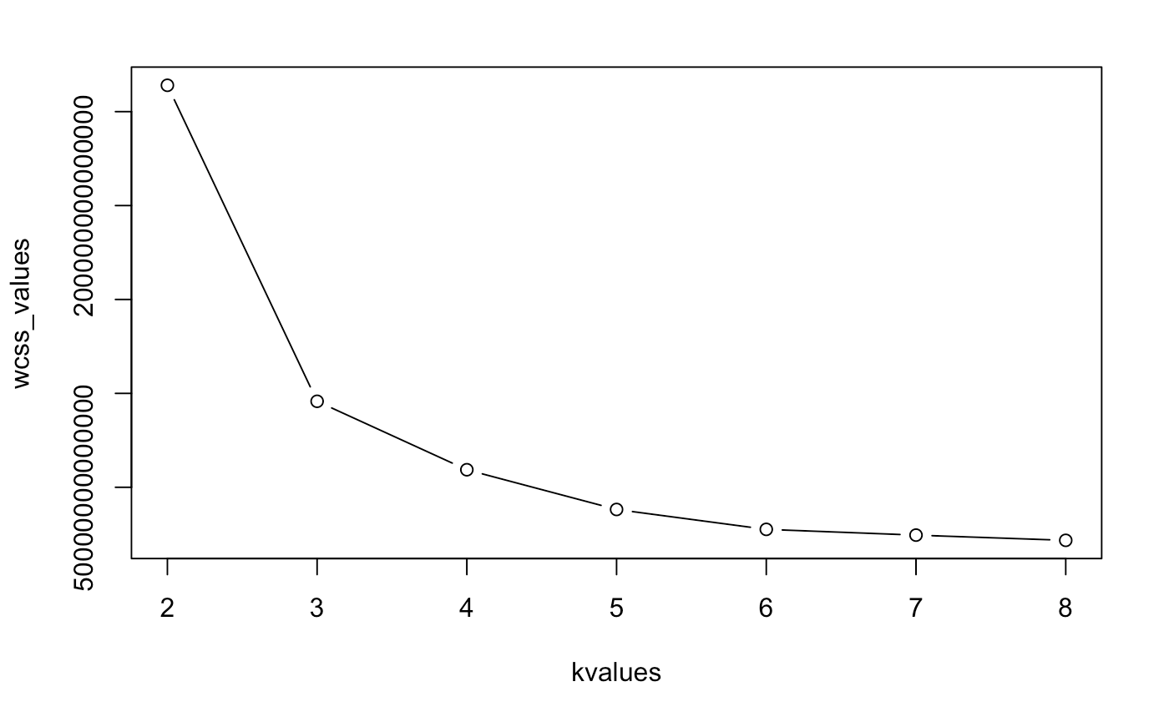
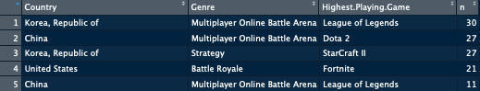
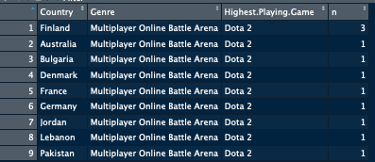
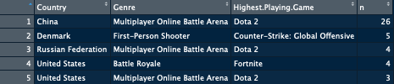
What Makes a Successful Gamer?: Top 500 Segments
Top 500 Earners analyzed, k means of 3 found to be best based off elbow plot
Segments
Segment 1 (“middle of the pack”)
422 players
Rank range between 79 and 500
Average prize money $415,091.10
Top genre is MOBA (40%) followed by FPS (31%)
Top game is DOTA (21%) followed by Counter-Strike (17%)
Top country is USA (23%) closely followed by Korea (19%)
Segment 2 (“best of the best”)
11 players
Rank range between 1 and 11
Average prize money $5,072,176.50
All MOBA genre
All play DOTA 2
Top country is Finland (33%)
Segment 3 (“high-performers)
67 players
Rank range between 12 and 78
Average prize money $1,714,623.20
Top genre is MOBA (78%)
Top game is DOTA 2 (76%)
Top country is China (39%)
Insights
Segment 1 best for USA
Segment 2 best for Finland
Segment 3 best for China
Top overall performers doesn’t necessarily indicate players are popular amongst viewers, more factors than just earnings need to be investigated too (social media presence/followers, personality, etc)
Most Frequent Player Profiles (Country, Genre, Game)

Slide 8
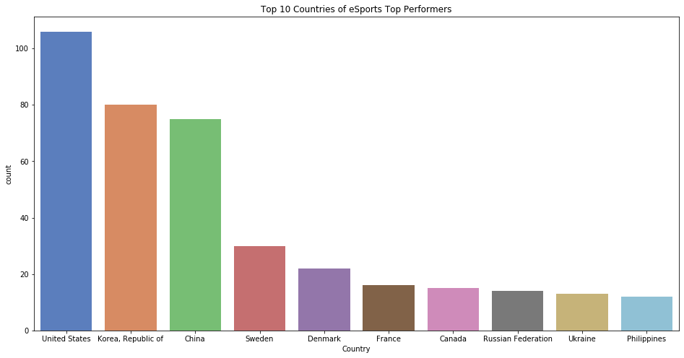
What Makes a Successful Gamer?: Country Stats
Most of the top earners come from USA (18%), Korea (12%), and China (14%)
Three of the top 11 earners are from Finland
For the top 500 eSports earners, linear regression finds that the countries of Australia, Finland, and Lebanon are statistically significant in regards to prize money

Slide 9


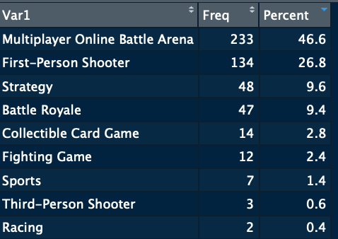
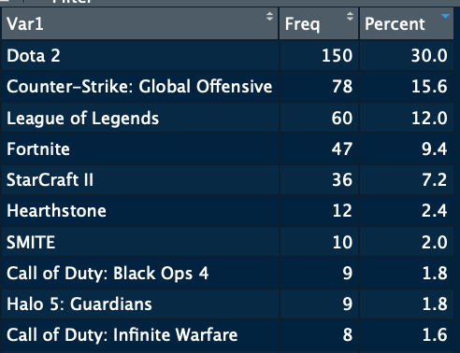
What Makes a Successful Gamer?: Game Stats
For the top 500 eSports earners, linear regression finds that the games DOTA 2 and Rainbow Six Siege are statistically significant in regards to prize money
Insights
46.6% of game Genres are Multiplayer Online Battle Arena (MOBA) and 26.8% are First-Person Shooter (FPS)
These two genres represent a 73.4% share of all 9 unique genres
DOTA 2 comprises 30% of top playing games
After the top 5 games, there is a big drop-off percentage-wise with mostly under 2% represented per game

Slide 10
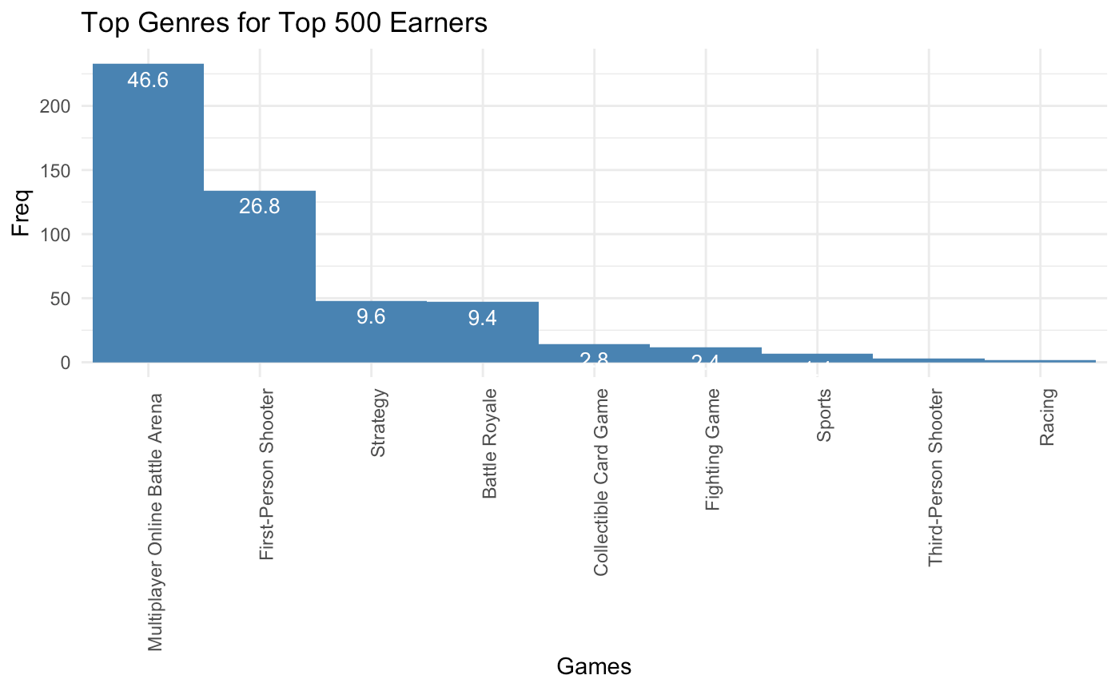

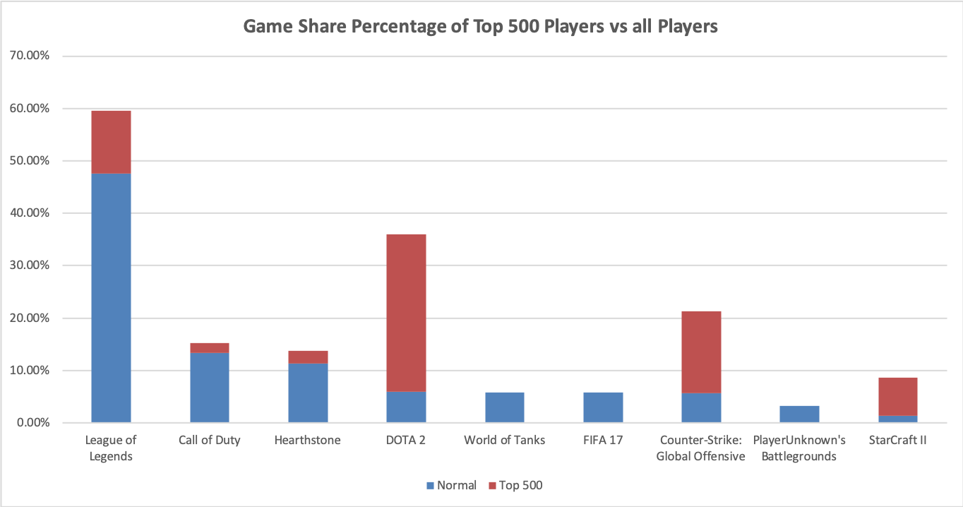
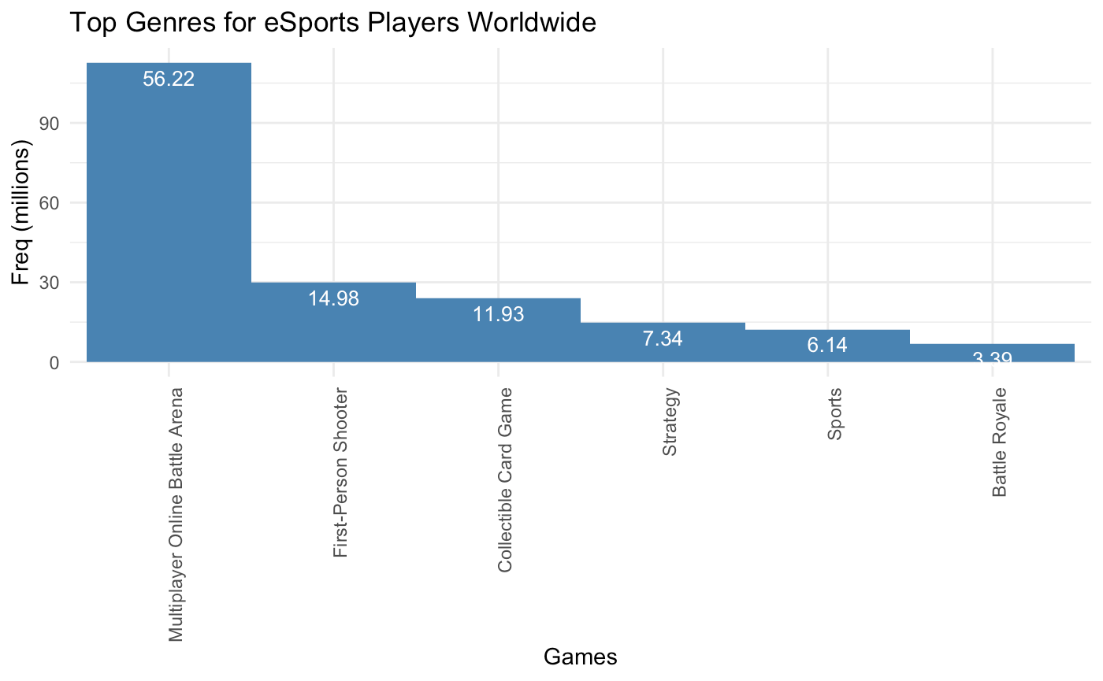

What Makes a Successful Gamer: Normal eSports Players vs Top Players
Different trends between all eSports players and top performers
47.62% of eSports players worldwide play League of Legends compared to the 12% of top 500 eSports players
Genres are very similar between the two groups with MOBA being dominant followed by First-Person Shooters
Battle Royale is more popular with top performers and Collectible Card Games are more popular with normal eSports gamers
Genre Breakdown
Game Breakdown

Slide 11
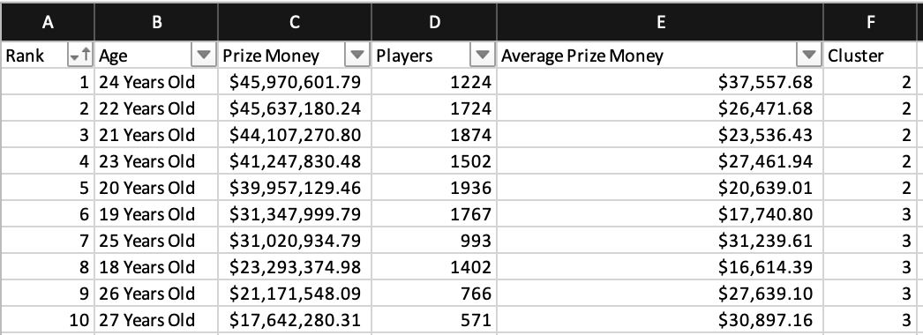
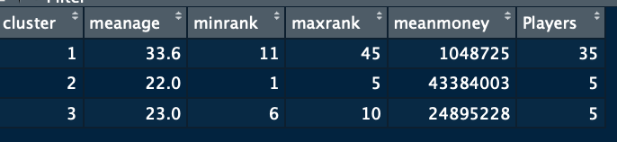
What Makes a Successful Gamer?: Age Stats
Top ages were clustered, k of 3 was determined by elbow plot
Segments
Segment 1 (“average-performing older earners”)
33.6 years old average
35 players
Rank range between 11 and 45
$1,048,725 average prize money
Segment 2 (“elite young earners”)
22 years old average
5 players
Rank range between 1 and 5
$43,384,003 average prize money
Segment 3 (“high-performing young earners”)
23 years old average
5 players
Rank range between 6 and 10
$24,895,228 average prize money
Insights
The top 5 player ages are 20-24 years old
The top 5 ages make almost double the prize money of the next top 5 ages ($43,384,003 vs $24,895,228 average prize money)
Age 24 group is highest total prize money along with highest average winnings per player

Slide 12
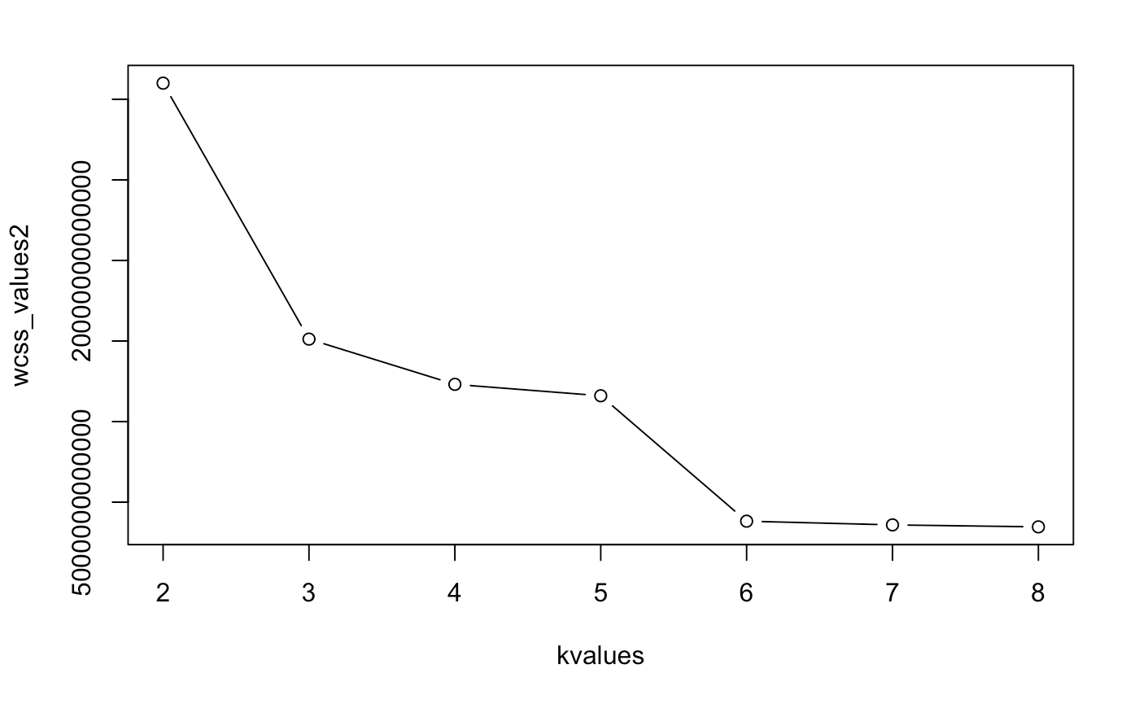
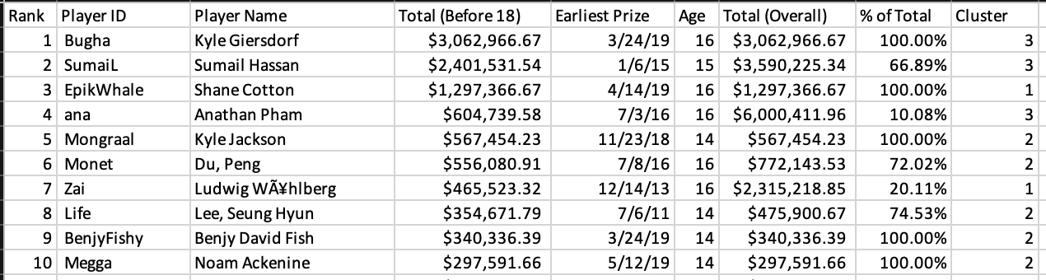
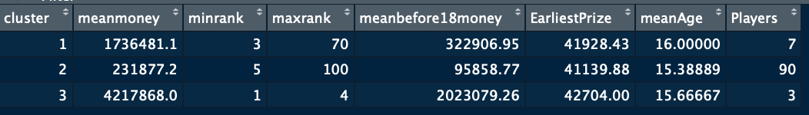
What Makes a Successful Gamer?: Under 18 Segments
Under 18 Earners analyzed, k means of 3 found to be best based off elbow plot
Segments
Segment 1 (“high-performing under 18 year olds”)
7 players
Rank range between 3 and 70
$1,736,481.10 average prize money
$322,906.95 average prize money before 18
$41,928.43 average earliest prize money
16 years old
Segment 2 (“middle-range under 18 year olds”)
90 players
Rank range between 5 and 100
$231,877.20 average prize money
$95,858.77 average prize money before 18
$41,139.88 average earliest prize money
15.39 years old
Segment 3 (“elite under 18 year olds”)
3 players
Rank range between 1 and 4
$4,217,868 average prize money
$2,023,079.26 average prize money before 18
$42,704.00 average earliest prize money
15.67 years old
Insights
Segment 3 makes more than double the average prize money of the next highest segment, Segment 2
The top 10 under 18 year olds make 41% of all under 18 year olds earnings (top-heavy)

Slide 13
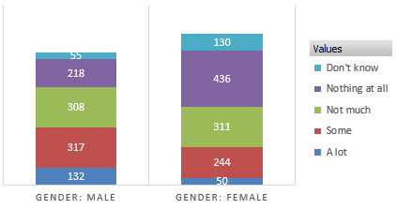
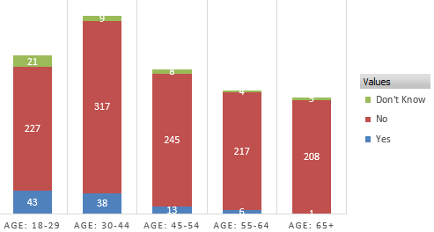
What is the makeup of an eSports viewers?: Gender/Age
Using National Tracking data, we want to assemble traits for potential advertising campaigns.
Questions for Participants
How much have you seen, read or heard about eSports and competitive video game tournament?
Have you ever participated in an eSports competition?
Have you ever watched an eSports competition on a streaming service?
Do you consider eSports a sport?
Gender Insights
Growing trend in new female gamers, with most revenue growth potential
27% males had not heard or seen an eSports tournament. Compared to Female participants with 48%
Female gamers may be a segment worth investigating.
Age Insights
Most active participants are 18-44 year olds combining 25%
18-44 year olds also count for 77.5% who have watched eSports on streaming service. (18-29 yo are highest at 42%)
79% of the entire range group think that eSports is probably/ definitely not or don’t know if it is a real sport

Slide 14
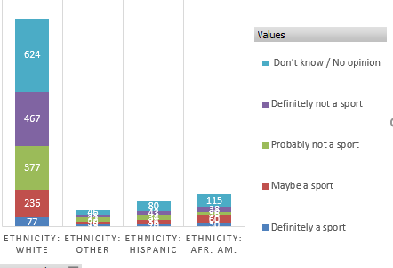
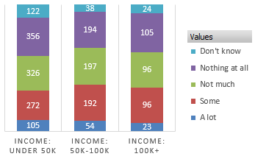
What is the makeup of an eSports viewers?: Income/Ethnicity
Questions for Participants
How much have you seen, read or heard about eSports and competitive video game tournament?
Have you ever participated in an eSports competition?
Have you ever watched an eSports competition on a streaming service?
Do you consider eSports a sport?
Income Insights
Similar trends for those who have watched an eSports competition (Some or A lot)
Under 50k @ 27%
50k-100k @ 24%
100k + @ 24%
Larger deficit in those that said “No” to having watched an eSports competition
Under 50k @ 67%
50k-100k @ 74%
100k + @ 74%
Ethnicity Insights
Sum of those that are unsure if eSports is a real sport. (probably/ definitely not or don’t know):
White 82%
Hispanic 74%
African American 68%
Potential Bias. Of those 1,501 participants surveyed by Ethnicity
White 1,071 (71%)
Hispanic 140 (9%)
African American 187 (12%)
Other 103 (7%)

Slide 15
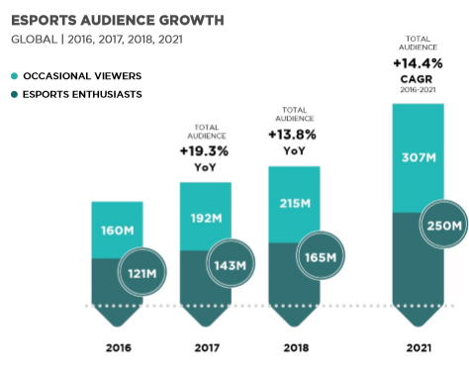
What is the makeup of an eSports viewers?:
What is the typical eSports viewer?
Male
18-29 years old
Under 50k
Higher percentages of Hispanic and
African American participation (viewing and competing)
With high opportunity for growth
Steady YOY audience growth
13.8% Growth in 2018
23 Million new Occasional Viewers
22 Million new eSports Enthusiasts
CAGR (Compound Annual Growth) of 14.4% from 2016-2021
Occasional viewers projected to surpass half a billion viewers
Current worldwide awareness 1.6 billion in 2018
Growing in emerging regions like Latin America, Middle East and Africa.
*Newzoo Free 2018 Global eSports Market Report

Slide 16
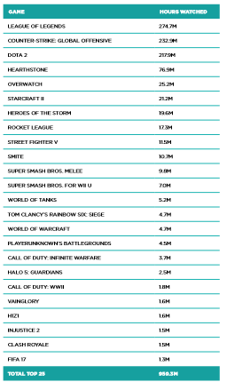
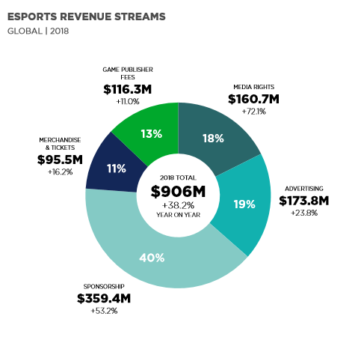
What is the makeup of an eSports viewers?:
Viewing behaviors
Top 5 eSports games watched on Twitch 2017
League of Legends, Counter-Strike, Dota 2, Hearthstone, and Overwatch
Over 950 Million Hours watched
eSports in 2018 generated $906 Million in revenue
38.2% YOY Growth
40% comes from sponsorship
23.8% comes from advertising
*Newzoo Free 2018 Global eSports Market Report
*Newzoo Free 2018 Global eSports Market Report

Slide 17
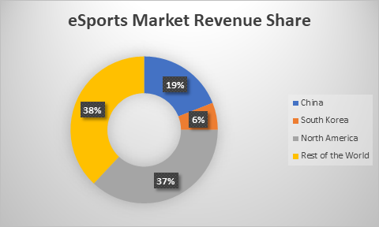
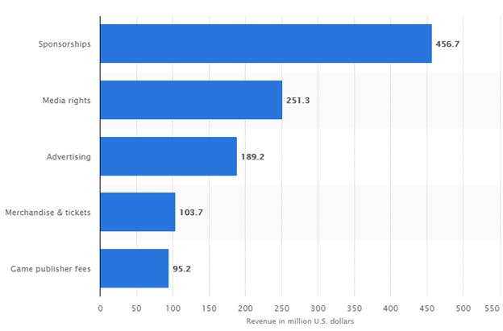
Where should advertisers spend marketing dollars?: Country
Currently, North America has the largest market revenue share for eSports.
This revenue share includes sponsorships, media rights, advertising, merchandise & tickets, and game publisher fees
*statista global revenue of eSports market 2019,by segment

Slide 18
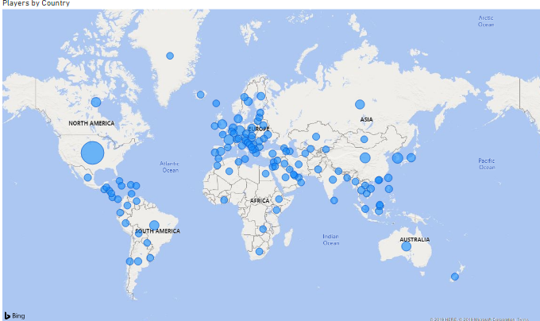
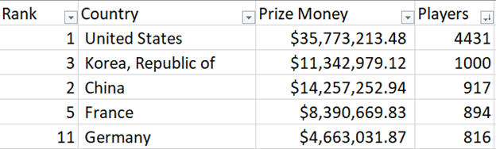
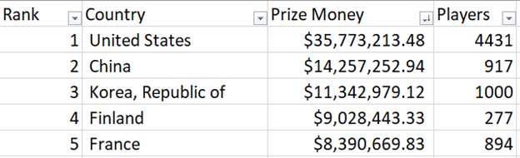
Where should advertisers spend marketing dollars?: Country
The United States, Korea, Chrina, and France ranked in the top 5 in both total amount of prize money and total number of players
Although the United States ranks 1 in the number of players, there is a large concentration of players in the European countries

Slide 19
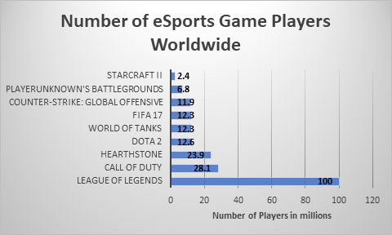
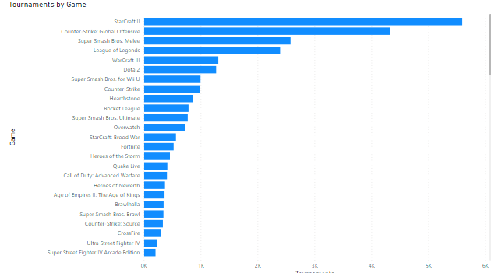
Where should advertisers spend marketing dollars?: Platforms/Games
According to SuperData Research, League of Legends was the most played eSports game of 2017.
In 2019, League of Legends ranked 4th highest game played at tournaments sorted by prize money
Starcraft II ranked 5th in overall prize money but 1st in total tournaments

Slide 20
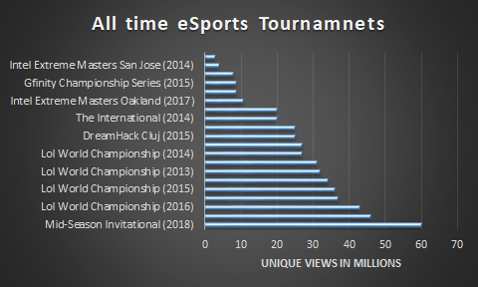
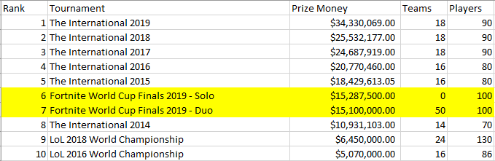
Where should advertisers spend marketing dollars?: Tournaments
70% of the all-time most viewed tournaments were either exclusively or partly League of Legends tournaments
Over the past 3 years, League of Legends tournament popularity has decreased slightly (ranked 9th and 10th in top tournaments.
While League of Legends tournaments have decrease, Dota 2 and Fortnite tournaments have increasingly popular

Slide 21
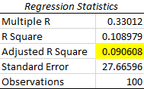
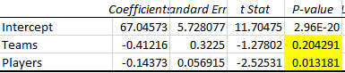
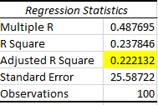
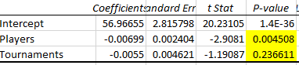
Where should advertisers spend marketing dollars?: Regression Results
Tourney Rank Regression
· After running regression on tournament rankings, the adjusted r square is low and the p-value for number of teams is high. This tells us that a tournament ranking by prize money isn’t related to the number of teams or players
Game Rank Regression
· Similar to tournament rankings, the game ranking based on prize money also had a low adjusted r square, although it was slightly higher than the tournament rank results.

Slide 22
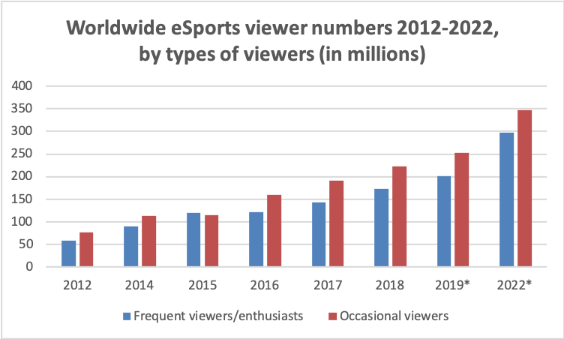
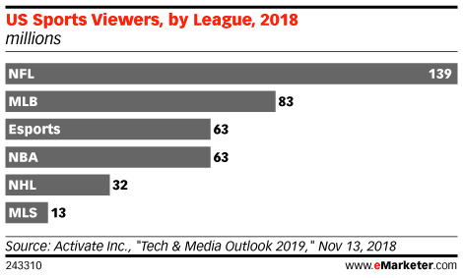
Conclusion: eSports is an Explosive Business Sector
eSports Viewership keeps on growing
Both frequent and occasional viewers numbers have been growing each year
Same viewership as NBA now

Slide 23
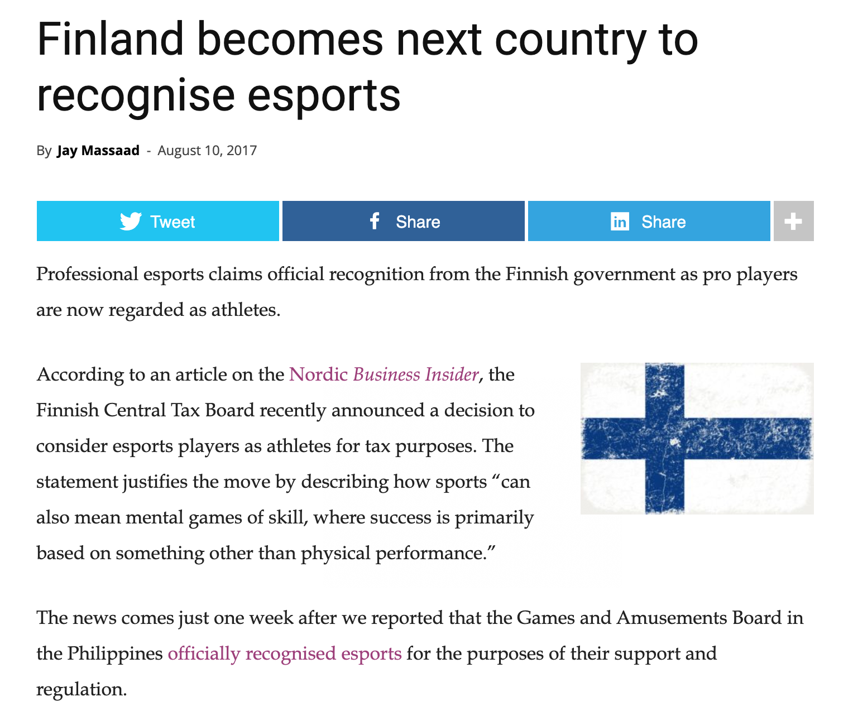
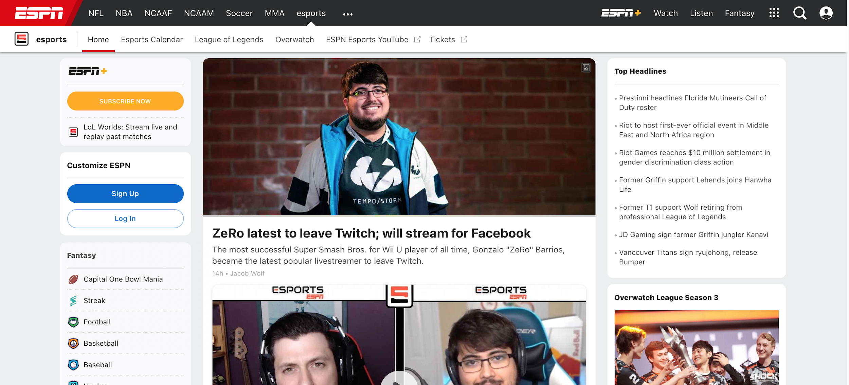
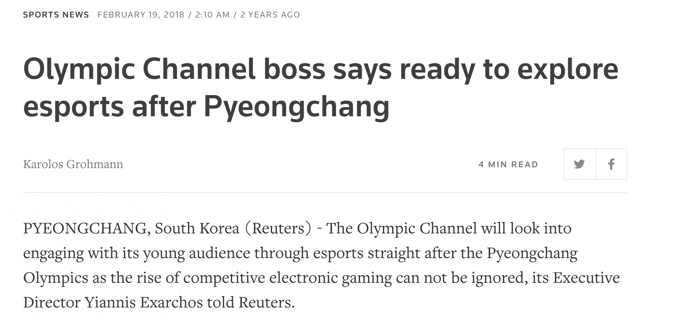
eSports Continues to Become more Legitimate Worldwide
eSports is becoming more and more legitimate around the world as it continues to overcome the preconceived notions of games not being deemed a real sport
Attitudes are changing towards video games
eSports players are becoming athletes for tax purposes, one of more recent countries was Finland, home of three of the top 11 eSports top performers
eSports has its own section on ESPN (ESPN broadcasts tournaments as well)
eSports is in consideration for being in future Olympics

Slide 24
eSports: Recommendations
Marketing Recommendations for Advertisers
Invest in MOBA and Battle Royale Genres
Decrease in League of Legends participation may show a trend in Battle Royale genres (Fortnite)
One thing to keep in mind is prize money and gamer population may not mean a larger market share
Find social media influencers popular in these genres and games
Sponsor players and teams popular with these genres/games, and advertise at relevant tournaments
Invest in Underutilized and High Potential Markets
Invest in Finland and significant countries like Australia and Lebanon
Female gamers
African American and Hispanic Ethnicities
Make partnerships with eSports professionals at an early age
The top eSports earnings age is 24 years old, find sponsorships and create partnerships early with under 18 year olds, invest early in their future
eSports is a young demographic and there are few successful eSports gamers past their mid 20s
Limited shelf-life, possibly due to burnout

Slide 25
Sources
https://www.esportsearnings.com/ (scraping API into CSV)
https://www.statista.com/statistics/506923/esports-games-number-players-global/
https://www.statista.com/statistics/490480/global-esports-audience-size-viewer-type/
https://www.statista.com/statistics/507491/esports-tournaments-by-number-viewers-global/
https://morningconsult.com/wp-content/uploads/2019/01/181231_crosstabs_ESPORTS_Adults_v2_AP-1.pdf (survey data)
https://venturebeat.com/wp-content/uploads/2019/09/high-school-2.jpg?w=760&resize=760%2C600&strip=all&strip=all (title page image)
https://www.emarketer.com/content/how-the-nba-is-using-esports-to-grow-its-audience (nba esports graph)
https://newzoo.com/insights/trend-reports/global-esports-market-report-2018-light/ (Newzoo Global 2018 Esports Market Report
https://seeklogo.com/images/D/dota-2-logo-7804D430C9-seeklogo.com.png (DOTA 2 logo)
https://steamcdn-a.akamaihd.net/steam/apps/359550/header.jpg?t=1575042419 (Rainbow Six Siege logo)
https://www.reuters.com/article/us-olympics-2018-ioc-esports/olympic-channel-boss-says-ready-to-explore-esports-after-pyeongchang-idUSKCN1G30JM (eSports olympics article)
https://www.espn.com/esports/
https://esportsinsider.com/2017/08/finland-recognises-esports/
https://www.statista.com/statistics/490358/esports-revenue-worldwide-by-segment/

